Slide 1
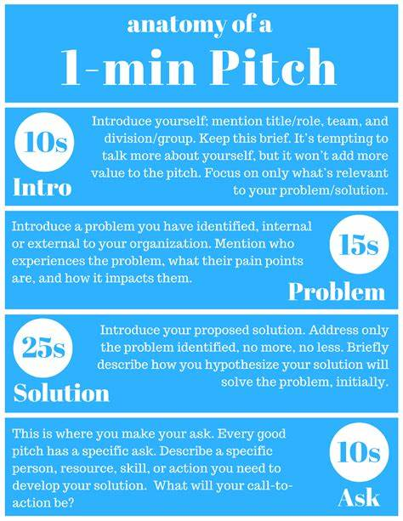
ARRIVE PREPARED TO BRIEF Rehearse in front of a clock Print page two out for the event so others can find your team and email a copy to saf.cn.bravo@us.af.mil for our records
Instructions to fill the form:
Replace the magenta text on the second page with your own words using the magenta writing as a prompt.
THIS IS AN UNCLASSIFIED PRODUCT

Slide 2
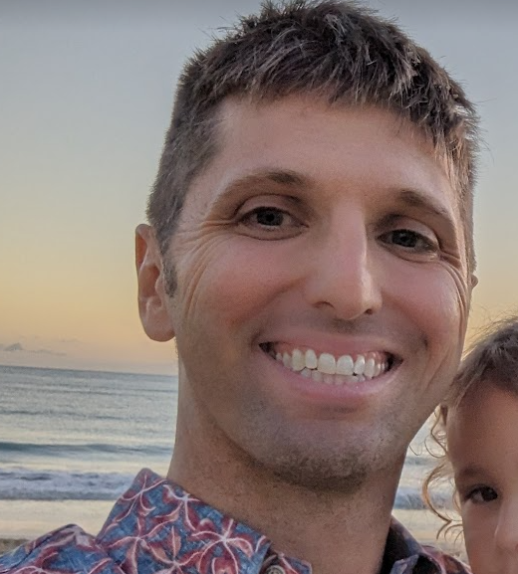
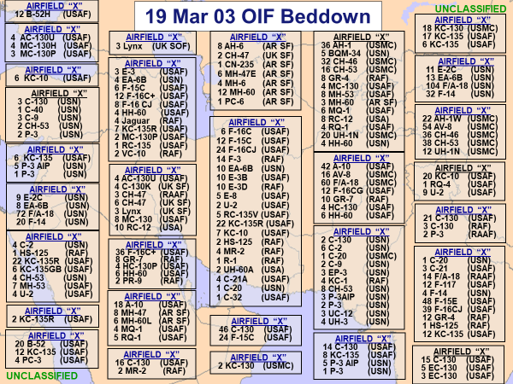
BRAVO 11 USE CASE BASEBALL CARD
UNCLASSIFIED
Gu$ Garcia, Maj, HIANG
Chief of Technology and Innovation
613 Air Ops Center, PACAF
Hawaiian Raptor F-22 Pilot
TOPGUN Navy Graduate
Mechanical Engineer
Friendly Order of Battle “Chat Bot”
Your digital library for planning and execution.
Me: I’m building “Shadow Operations Center – Hawaii” and the PACAF Sandbox. Focused on Operational to Tactical integration my whole career. I’ve launched off aircraft carriers in an F/A-18 and an improvised runway in an F-22.
Problem: Need help aggregating and making available the status of our Blue Force. (Disposition of Forces aka FrOB)
Data available: PACAF, HIANG, and US IPC
Idea: A fully informed LLM of joint blue capabilities. This will augment the joint expertise our LNO’s, email, MS sharepoint, and chat provide today.
Why: Accelerate awareness of our allied posture.
Who: Operations Centers and Lead Wings will be the first customer of this product.
What: Break down silos and turn data into knowledge.
I’ll be primarily in the CUI area
Reach me on Discord: Gu$ (magnuzno) Signal: 808-431-1295
Created 613 Air Operation Center’s Innovation Cell. Building the PACAF Sandbox to support a future “ShOC-H.” We have a team of warfighter SME from C3BM, ABMS, STITCHES, TAK, Joint Services and Coalition partner nations.
Check out this A/A beddown from 2003.
We’ve got our work cut out for us
Bits2Effects
UNCLASSIFIED

Slide 3
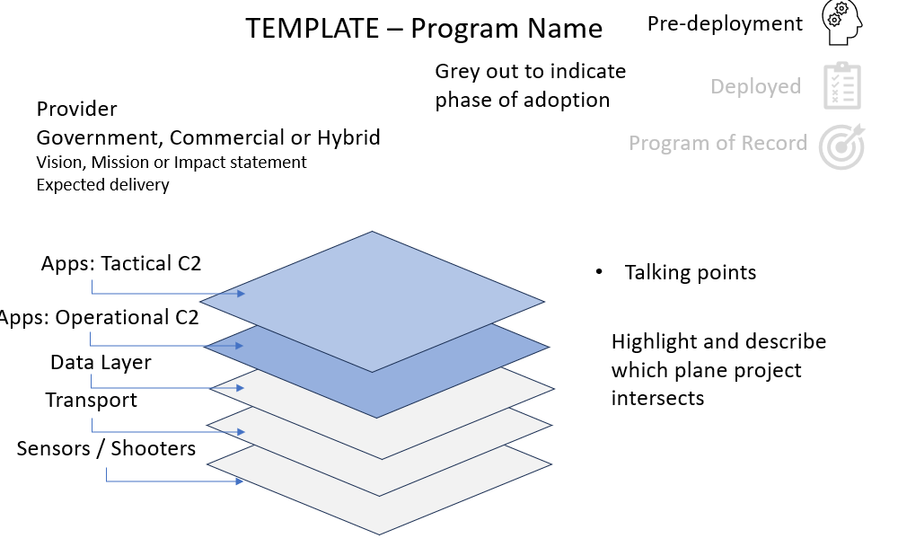
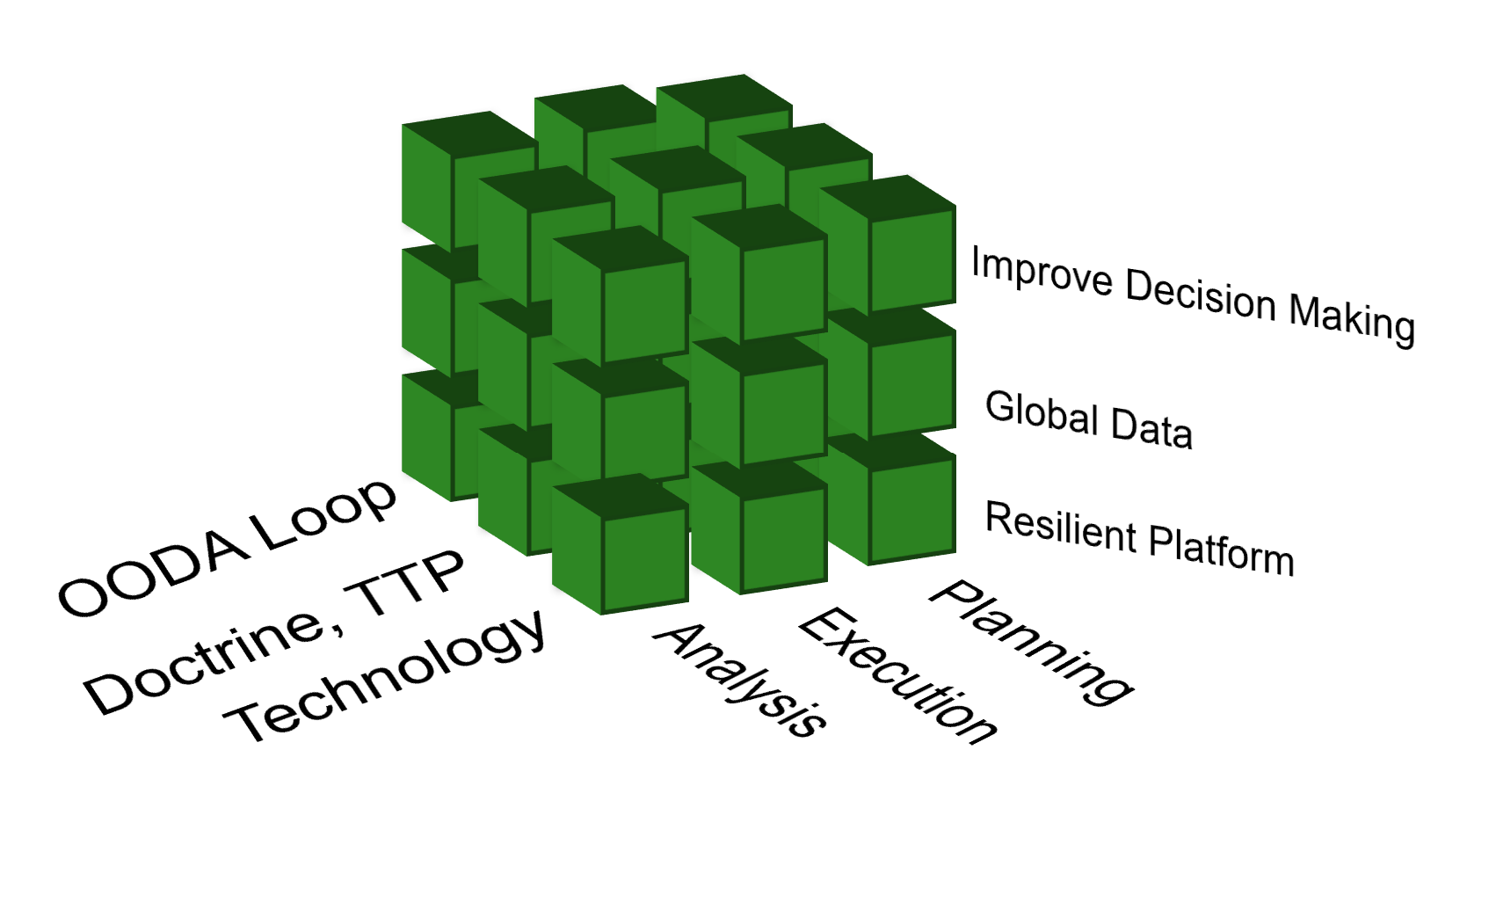
BRAVO 11 USE CASE BASEBALL CARD
UNCLASSIFIED
Gu$ Garcia, Maj, HIANG
Chief of Technology and Innovation
613 Air Ops Center, PACAF
Hawaiian Raptor F-22 Pilot
TOPGUN Navy Graduate
Mechanical Engineer
Help us render and visualize the CJADC2 app store.
“What was your program again? That sounds a lot like XXX”
Me: I’m building the PACAF Sandbox. Focused on Operational to Tactical integration my whole career. I’ve launched off aircraft carriers in an F/A-18 and an improvised runway in an F-22.
Problem: No one has a fully informed conceptual model of all of the “good ideas” trying to help solve “CJADC2”. Siloed efforts mean most people see only a small fraction of the possible solutions currently in work.
Data available: 169 examples to model = apps and technology partners contributing to a complex ecosystem
Idea: An onboarding website to collect and information about solutions. Then rendered as a 3D constellation of interconnected systems of systems.
Why: We can finally figure out what everyone is doing.
Who can help? Graphic and web designers, marketers, OSI model experts, conceptual model experts, project managers
I’ll be primarily in the CUI area
But you can reach me on Discord at: Gu$ (magnuzno)
Created 613 Air Operation Center’s Innovation Cell. Building the PACAF Sandbox to support a future “ShOC-H.” We have a team of warfighter SME from C3BM, ABMS, STITCHES, TAK, Joint Services and Coalition partner nations.
Bits2Effects
UNCLASSIFIED

Slide 4
BRAVO 11 USE CASE BASEBALL CARD
UNCLASSIFIED
Gu$ Garcia, Maj, HIANG
Chief of Technology and Innovation
613 Air Ops Center, PACAF
Hawaiian Raptor F-22 Pilot
TOPGUN Navy Graduate
Mechanical Engineer
F-22 Optimized Flying Schedule.
“Save us 60-90 man hours every month.”
Me: I’m building “Shadow Operations Center – Hawaii” and the PACAF Sandbox. Focused on Operational to Tactical integration my whole career. I’ve launched off aircraft carriers in an F/A-18 and an improvised runway in an F-22.
Problem: The Hawaiian Raptors spend tremendous manpower building a monthly flying schedule that could easily be automated.
Data available: Details Years of monthly and annual flying schedules and training requirements.
Idea: Proof of concept to automate the production of this complex schedule.
Why: We can finally figure out what everyone is doing.
Who can help? Graphic and web designers, marketers, OSI model experts, conceptual model experts, project managers
I’ll be primarily in the CUI area
Reach me on Discord: Gu$ (magnuzno) Signal: 808-431-1295
Created 613 Air Operation Center’s Innovation Cell. Building Shadow Operations Center – Hickam and the PACAF Sandbox. We have a team of warfighter SME from C3BM, ABMS, STITCHES, TAK, Joint Services and Coalition partner nations.
Bits2Effects
UNCLASSIFIED

